Slide 1



Integrated Program in Business Analytics
Non-Performing Assets in banks, How to Minimize it with the help of Loan Eligibility.
GROUP H:
Ayushi Tiwari
Dhruv Saini
Heena Raj
Jaydeep Mukherjee
Nikhil Dhania
Pooja Verma

Slide 2
Agenda
Business Problem and Objectives
Executive Summary
Data Overview and Key Business Assumptions
Data Preparation and Pre-processing:
Sanity checks, treatment and transformations for analytical dataset preparation
Exploratory Data Analysis:
Key Business Findings and Insights
Model Development and Validations:
Model comparisons on key scoring metrics and model finalization
Dashboarding
Businesss Recommendations and Potential Business Impact
Next Steps/ Suggestions for Future
Appendix

Slide 3



Business Problem and Objectives:
Business Problem
Objectives
Loss of Revenue
Capital Erosion
Reduce NPA through Loan eligibility prediction.
Business Problem and Objectives
Reputational Risk
Threat to bank’s financial stability
Prevention of losses due to NPA.

Slide 4



NPA (Non-Performing Asset) : (Non-Performing Asset)
NPA (Non-Performing Asset) are assets where interest or principal payments are overdue for about 90 days and indicating credit default risk
NPAs decrease profitability and weaken capital reserves of public sector banks
They disrupt bank operations, macroeconomic performance, and lending activities
NPAs have an inverse relationship with Return on Equity (ROE).They raise the cost of capital, inflation, and impede economic growth
NPAs have a negative impact on the broader national economy
IMPACT
FY23 Gross NPAs for commercial banks: ₹5.7 lakh crore
Public sector banks' share: ₹4.2 lakh crore, the highest
Private banks NPAs: ₹1.2 lakh crore
Foreign banks NPAs: ₹9,526 crore
Small finance banks NPAs: ₹8,608 crore

Slide 5





KEY-FINDING
RECOMMENDATION
PURPOSE
Identifying critical factors influencing loan repayment behavior and recommending strategies for risk mitigation.
Refining loan approval processes, offering financial counseling, and adjusting risk management strategies to minimize NPAs.
Developing strategies to minimize NPAs by optimizing loan approval processes based on customer eligibility criteria.
INTRODUCTION
CONCLUSION
Emphasizing the importance of data-driven approaches in managing NPAs and ensuring sustainable growth in the banking sector.
Addressing the challenge of NPAs in banking and proposing data-driven solutions.
EXECUTIVE SUMMARY

Slide 6
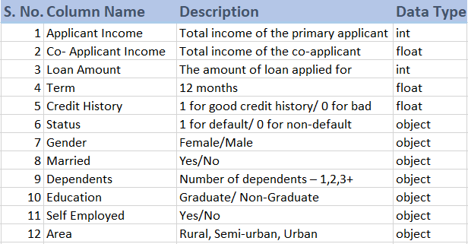
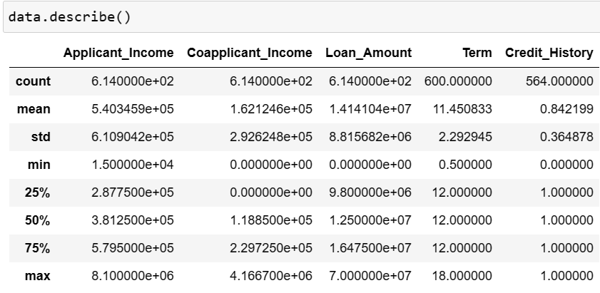
Data Overview:
Here is an overview of the dataset columns, detailing their respective attributes:

Slide 7
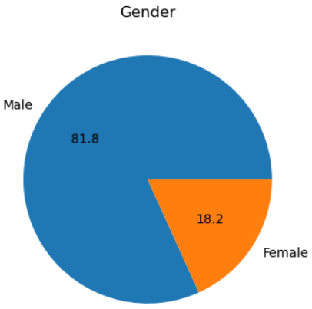
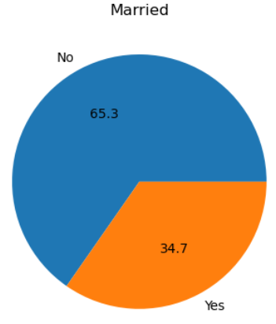
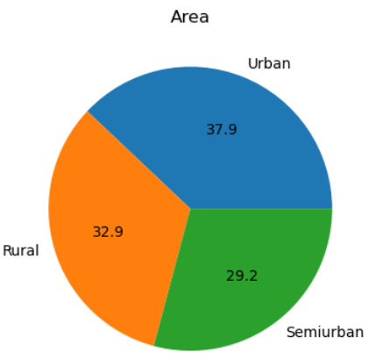
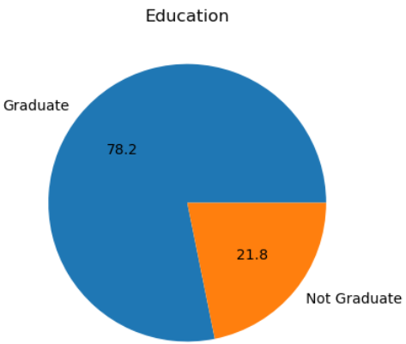
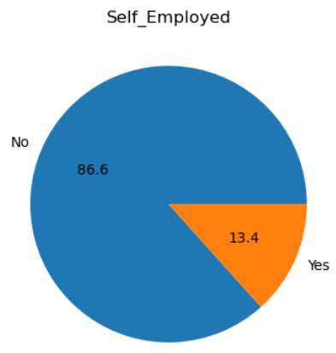
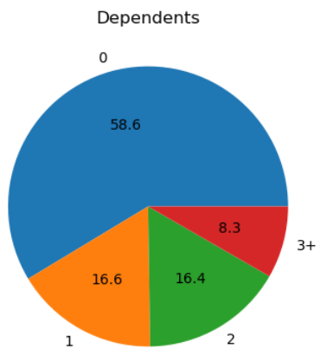
Key Assumptions: Comparing data distributions across different categories, based on our underlying assumptions

Slide 8
Data Preparation and Pre-processing:
01
02
03
04
05
Handling Imbalanced Data
Data Collection
Data Cleaning
Data Engineering
Final check
Source - The data is collected from Kaggle. It is available at: https://www.kaggle.com/datasets/mirzahasnine/loan-data-set
Missing values treatment ('Gender', 'Married', 'Term', 'Dependents', 'Self Employed’ and 'Credit History‘).
Outlier treatment
Data type conversion : One hot encoding technique
Applied class weights to address class imbalance
Used clean data for modelling techniques

Slide 9
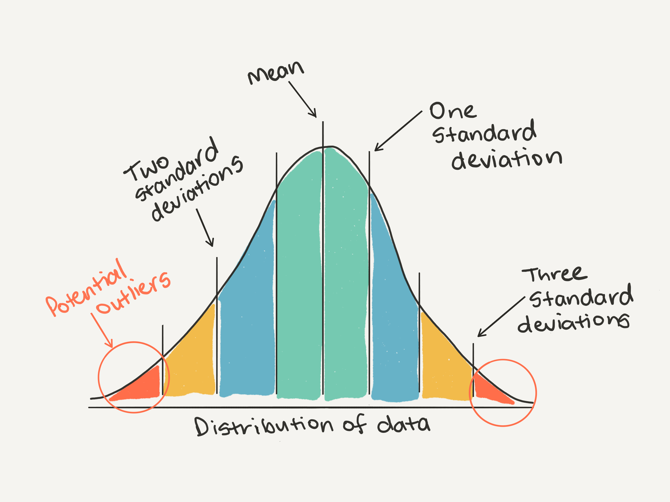
Exploratory Data Analysis:
It's an approach to analyzing data sets to summarize their main characteristics, often using statistical graphics and other data visualization methods.
Data Visualization
Correlation Analyses
Data Distribution Analysis
Univariate & Multivariate Analysis

Slide 10
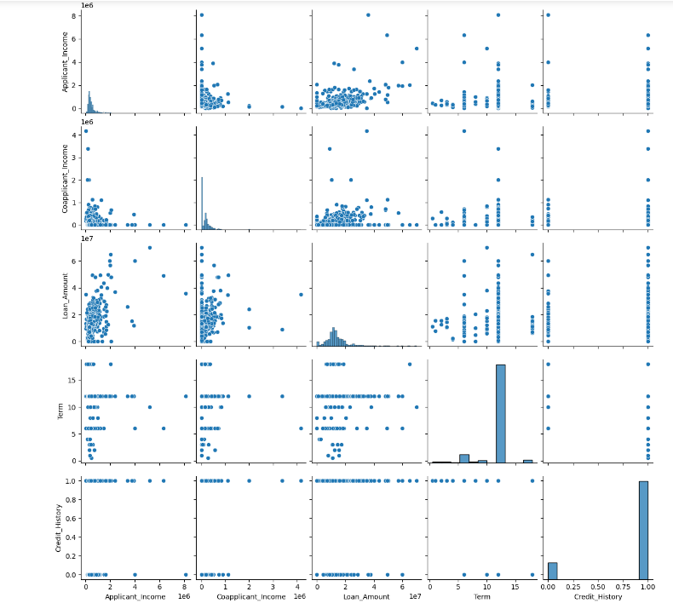
Correlation Check Using Pair Plot:
Scatter plot showing correlations between multiple Variables.

Slide 11
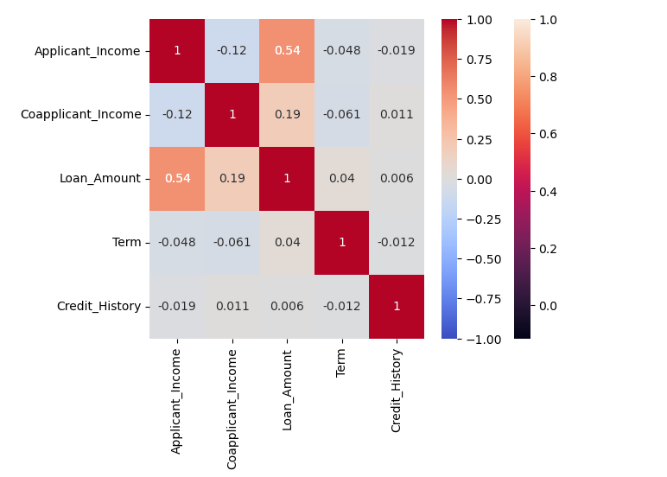
Correlation Check Using Heat Map:
Interpretation: Loan Amount is positively correlated with applicant income, co applicant income, term and credit history.

Slide 12
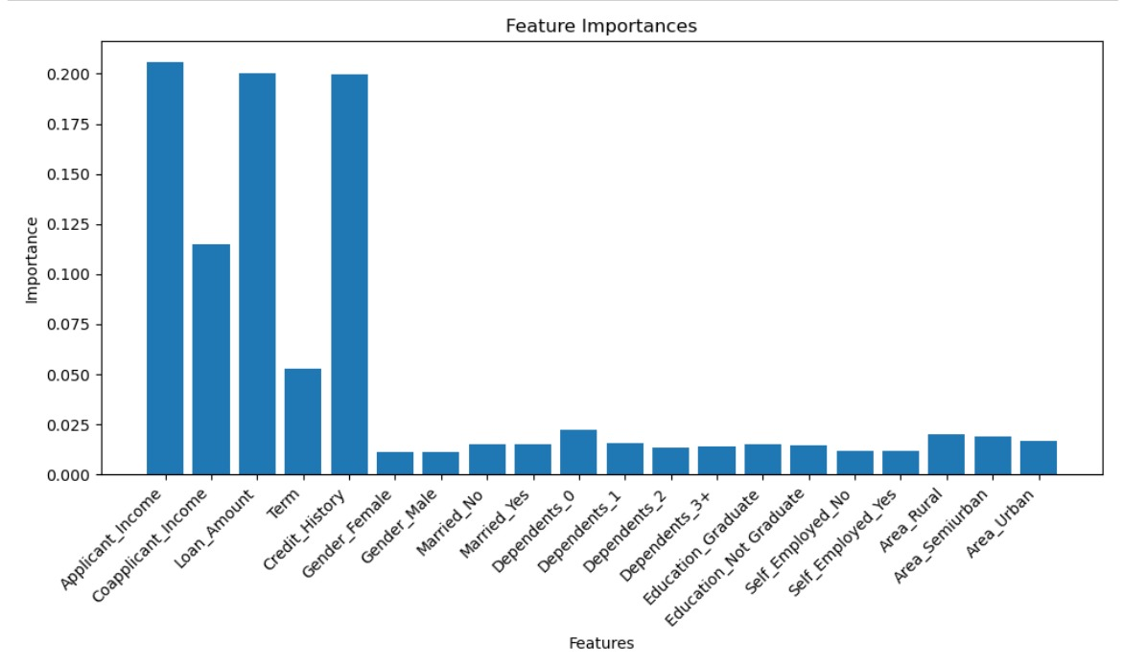
Features Importance:

Slide 13
Random Forest Classifier
We have used Random Forest classifier for loan data eligibility assessment by leveraging its ability to handle both numerical and categorical features, handle non-linear relationships, and provide feature importance analysis.
XGBOOST Classifier
Use of XGBoost Classifier has helped us conduct feature selection to identify relevant features that may impact loan eligibility, avoiding Overfitting & Underfitting, Balancing Data, getting even more accurate results by more iterations, making informed decisions based on applicants' characteristics and financial history while minimizing risks associated with loan defaults.
Decision Tree Classifier
Chosen for its interpretability and capability to identify key factors contributing to loan defaults. Decision trees help in understanding the decision-making process behind loan eligibility, aiding in proactive NPA management.
Logistic Regression
It iterates through penalty types, regularization strengths, solvers, and class weights to find the combination yielding the highest accuracy on the training data. Its simplicity and interpretability make it useful for initial analysis and setting threshold values for loan approval to minimize NPAs.
ML MODELS USED

Slide 14
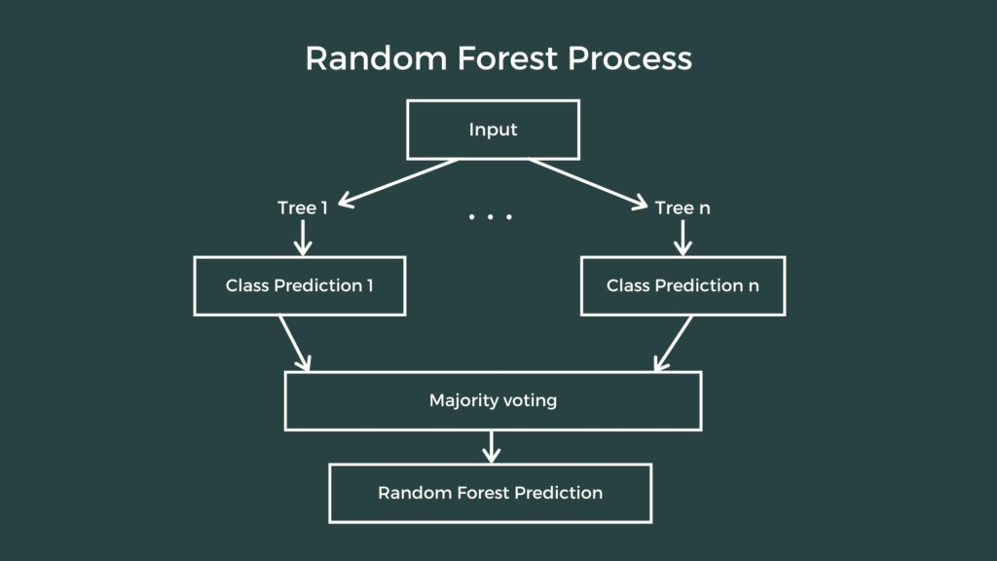
RANDOM FOREST CLASSIFIER:
It is robust to overfitting and performs well on a wide range of classification tasks
It can handle both numerical and categorical features without requiring feature scaling or one-hot encoding
It provides built-in feature importance analysis, helping users understand the relative importance of different features
It is relatively easy to tune and less sensitive to hyperparameters compared to some other algorithms

Slide 15
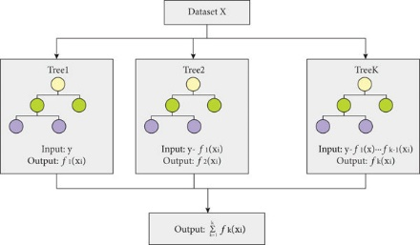
XG BOOST CLASSIFIER:
XGBoost is known for achieving top performance in machine learning tasks, especially classification and regression problems
It's designed to handle large datasets efficiently
XGBoost incorporates techniques to prevent overfitting
It can handle both numerical and categorical features without additional steps like scaling or encoding
XGBoost provides tools to understand which features are most important for making predictions
Effective with defaults, it allows for customization to further optimize results

Slide 16
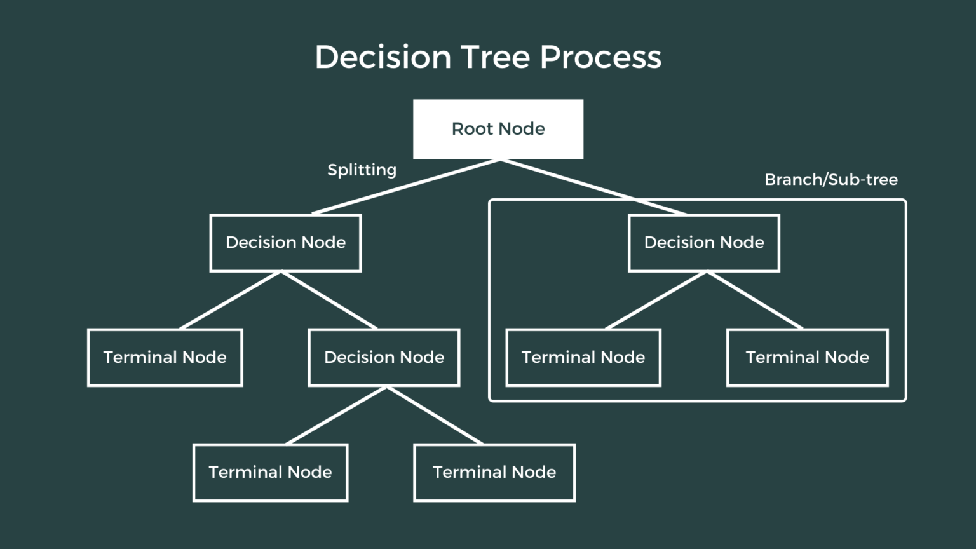
DECISION TREE CLASSIFIER:
Decision trees are known for their transparency. We can easily follow the tree structure and understand the logic behind each prediction
They can handle categorical data directly and work with missing values, reducing preprocessing needs.
Decision trees offer exceptional interpretability due to their inherent structure
Decision trees can be prone to overfitting if not carefully controlled (e.g., with pruning).
Decision trees are generally fast to train compared to some other complex machine learning models

Slide 17
LOGISTIC REGRESSION :
Input Data
Logistic regression is primarily designed for tasks involving two possible outcomes, making it ideal for predicting probabilities of events like email spam or loan defaults
The model coefficients reveal how each feature influences the predictions, offering some insights
Data outliers can heavily influence predictions, so it's important to consider handling them before training
Training a logistic regression model is fast and requires fewer resources compared to complex models
It struggles with complex, non-linear relationships between features
Data Pre-processing
Feature Selection
Applying Logistic Regression Algorithm
Performance Measure

Slide 18
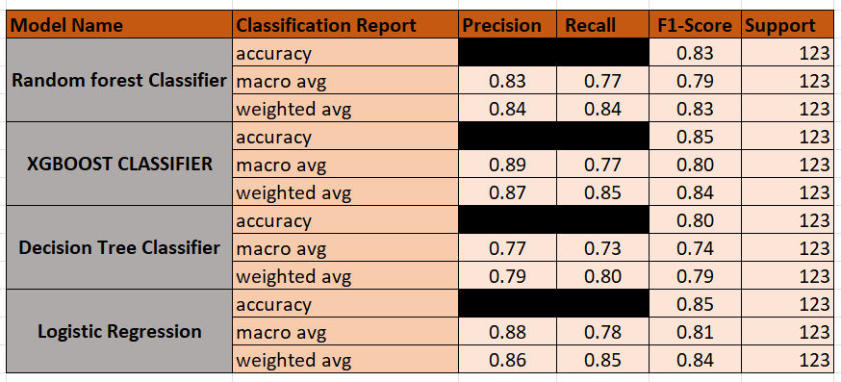
Model comparisons on key scoring metrics and model finalization:

Slide 19
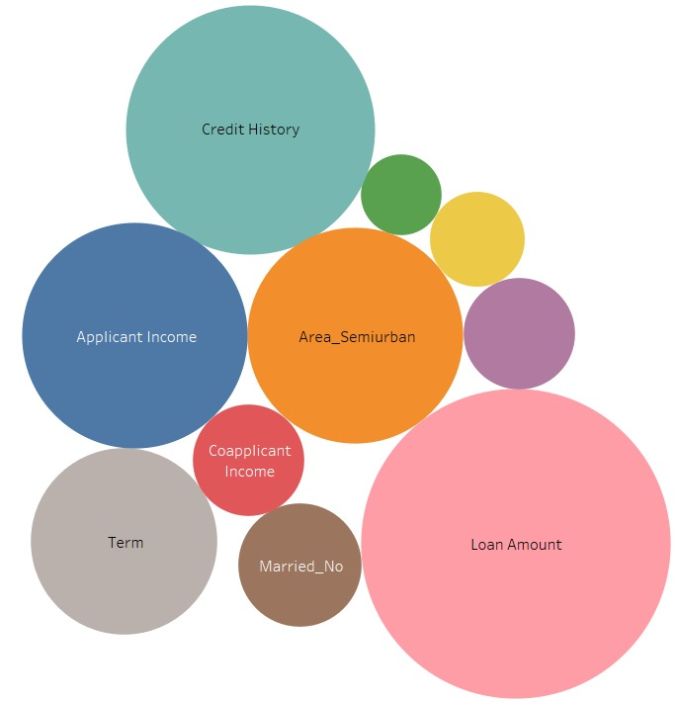
Dashboard
MODEL | ACCURACY
RANDOM FOREST CLASSIFIER | 82.9%
XG BOOST CLASSIFIER | 85.4%
DECISION TREE CLASSIFIER | 79.6%
LOGISTIC REGRESSION | 85.3%

Slide 20




Businesss Recommendations:
Data Analysis and Segmentation:
01
Employ advanced analytics to segment NPA loans based on loan details, borrower profile, and repayment history for targeted attention.
01
03
Predictive Modeling:
02
Develop machine learning models to forecast NPAs, enabling proactive risk mitigation via loan eligibilty.
04
Early Warning System for NPA Detection:
03
ML early warning system detects NPA risks using historical data to predict delinquency or default.
Automated Decision Support Systems:
02
04
A system that assist loan officers and credit risk managers in NPA management by Integrating ML models into loan origination and credit underwriting processes.

Slide 21
Potential Business Impact:
1. Risk Mitigation and Loss Reduction
3. Enhanced Operational Efficiency
5. Improved Decision-Making and Resource Allocation
2. Regulatory Compliance and Risk Governance.
4. Competitive Advantage and Customer Trust

Slide 22

Suggestions for future work or enhancements to the project:
1. Feature Engineering: Explore additional features that may improve the predictive power of the model. This could involve creating new features, transforming existing ones, or incorporating external datasets for additional information.
2. Advanced Modeling Techniques: Experiment with more advanced machine learning algorithms or ensemble methods to further improve model performance. Consider techniques such as Neural Networks, or ensemble methods like stacking or blending.
3. Hyperparameter Tuning: Perform a systematic hyperparameter tuning process to optimize the parameters of the model. Use techniques such as grid search, randomized search, or Bayesian optimization to find the best combination of hyperparameters.
4. Model Interpretability: Enhance the interpretability of the model by using techniques such as feature importance analysis, SHAP (SHapley Additive exPlanations) values, or partial dependence plots to understand how different features impact the model's predictions.

Slide 23
Further enhancement steps for improvement
5. Model Evaluation Metrics: Consider additional evaluation metrics beyond the ones already used (e.g., accuracy, precision, recall, F1-score). Depending on the problem domain, metrics like ROC-AUC, precision-recall curve, or cost-sensitive metrics may provide more meaningful insights into model performance.
6. Cross-Validation and Validation Strategies: Implement rigorous cross-validation techniques to assess the stability and generalization performance of the model. Consider using techniques like k-fold cross-validation, stratified sampling, or time-series cross-validation for robust evaluation.
7. Model Deployment & Monitoring: Develop a strategy for deploying the model into production and monitoring its performance in real-time. Implement mechanisms for tracking model drift, detecting concept drift, and updating the model as needed to ensure its continued effectiveness over time.
8. Domain-Specific Insights: Collaborate with domain experts to gain deeper insights into the problem domain and identify potential areas for improvement or refinement in the model. Domain knowledge can often lead to valuable insights and improvements in predictive modeling tasks.

Slide 24
Appendix
Historical Loan Data: https://www.kaggle.com/datasets/mirzahasnine/loan-data-set
Facts Reference: https://rbi.org.in/
Articles: https://www.theclickreader.com/decision-tree-classifier/
Images: https://plutusias.com/air-india-disinvestment-story-entering-the-concluding-stage-the-indian-express-gs-3/

Slide 25
THANK YOU

